Slide 1

Software Engineering
Developing under architecture
Harald Drillenburg
Year 2 2nd term

Slide 2
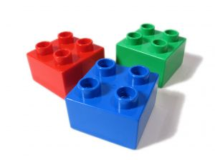
Course structure
Principles of Software Engineering
The zen of project planning
Developing under architecture
Designing with patterns
Testing and continuous integration
Test Driven Development
Architecture in Agile projects
Year 2 2nd term

Slide 3
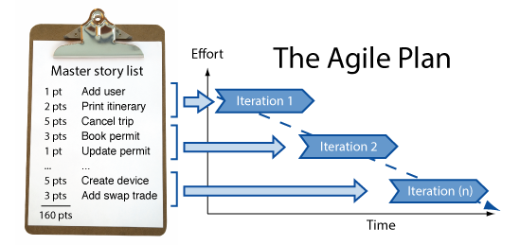

Discussion: project plan for EPD
Year 2 2nd term

Slide 4
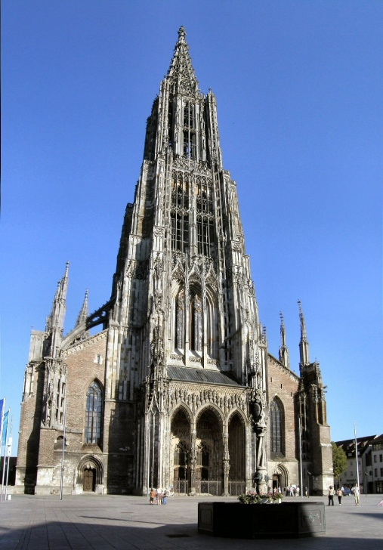
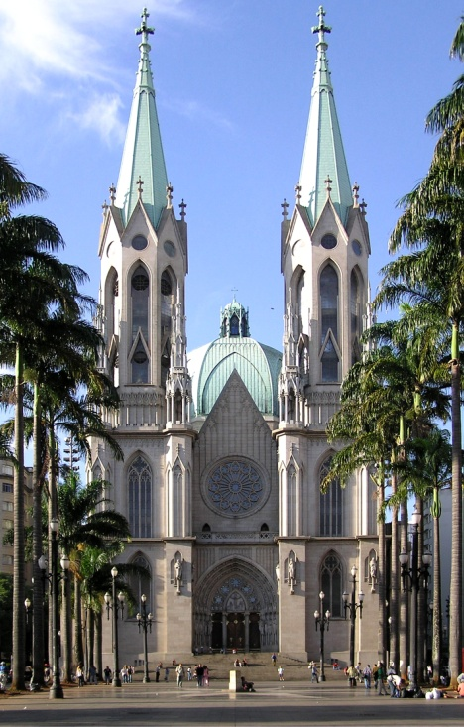
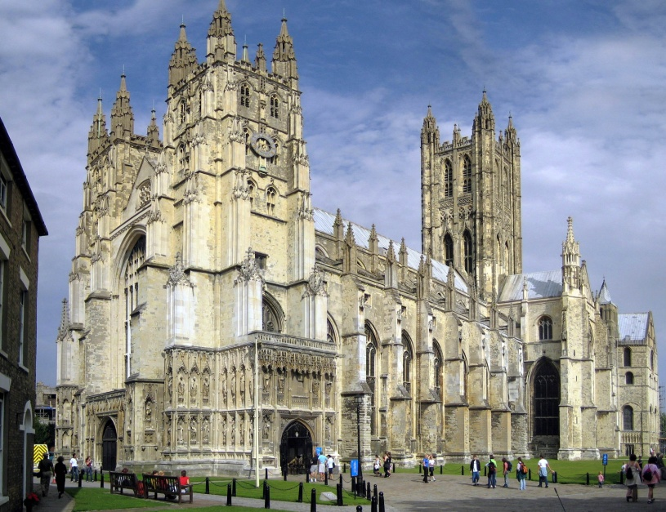
What is architecture?
When you have a structure and take away
everything non-essential, what remains is the
architecture
Year 2 2nd term

Slide 5
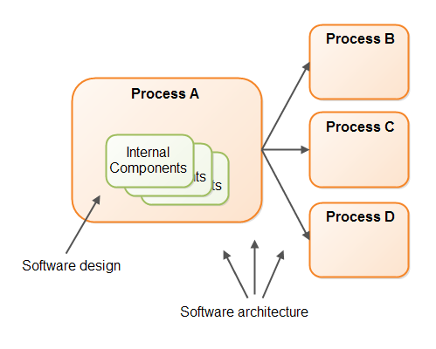
What is software architecture?
The software architecture of a program or
computing system is the structure or structures
of the system, which comprise software
elements, the externally visible properties of
those elements, and the relationships among
them.
Year 2 2nd term

Slide 6
What is software architecture?
So, a software architecture:
Defines elements and their relationships
Is composed of more than one structure
Can be good or bad, but can never be absent
Can be documented or not
  Though it always should be documented!
Has a major impact on future development
Year 2 2nd term

Slide 7
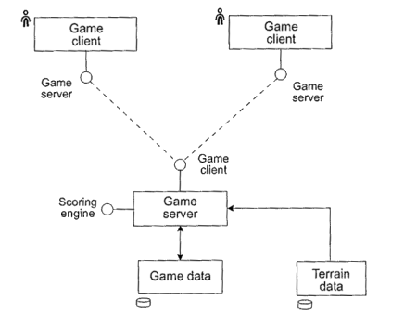
Example of software architecture
Year 2 2nd term

Slide 8
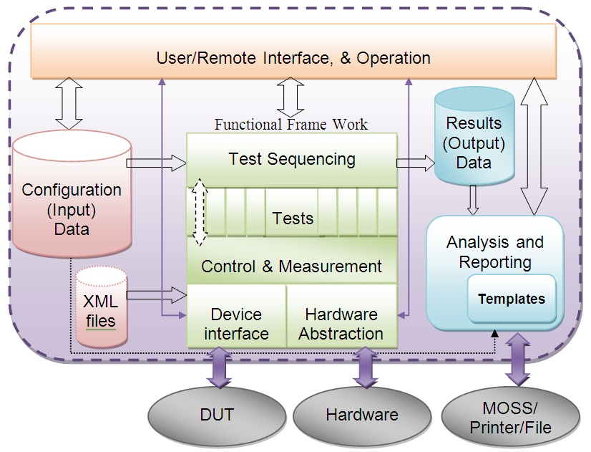
Example of software architecture
Year 2 2nd term

Slide 9
What is software architecture?
So, a software architecture:
Can be simple or complex
Should fit the purpose of the software
Needs to be adaptable
Is created by an artist as well as a technician
Year 2 2nd term

Slide 10
How to design a good architecture
Have one (or few) people design it
Base it on the concept of quality attributes
Document it using different views
Evaluate it against the envisioned system
Make sure it works well with iterations
Year 2 2nd term

Slide 11
Signs of a good architecture
Well-defined modules
Uses well-known patterns
  Design patterns
  Architectural patterns
No strong dependency on commercial suits
Separation of data production and data consumption
Multithreading is common
Strong cohesion, weak coupling
Clear guidelines on important areas in the software
Year 2 2nd term

Slide 12
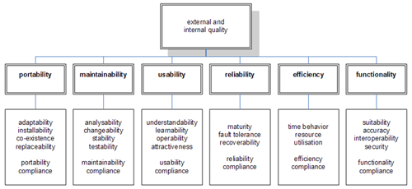
Quality attributes
Year 2 2nd term

Slide 13


Exercise: quality attributes
Determine the four most important quality
attributes for the privacy case study
Year 2 2nd term

Slide 14
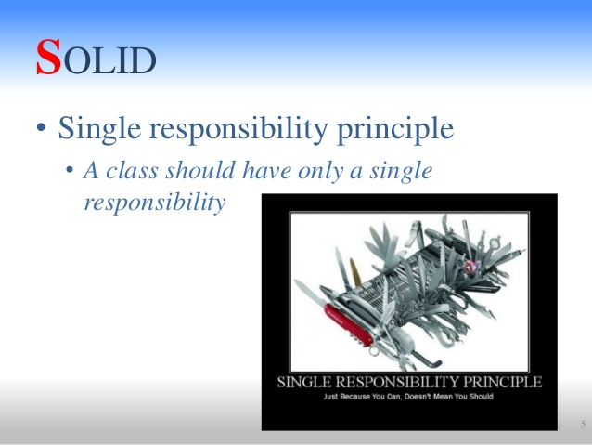
Single Responsibility Principle
SRP
Do one kind of thing
Do that well
Do that in full
Year 2 2nd term

Slide 15
SRP Analysis
The <<classname>> should <<method>> itself
The Cow should graze() itself ->
  check, graze is a good method for Cow
The Cow should shoot() itself ->
  No, that sounds weird.
  The Hunter should shoot(Cow) itself qualifies
  Class Hunter determined
eat()?
feed()?
giveBirth() ?
Year 2 2nd term

Slide 16
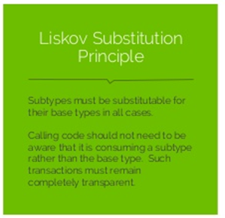
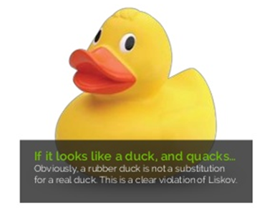
Liskov Substitution Principle
Year 2 2nd term

Slide 17
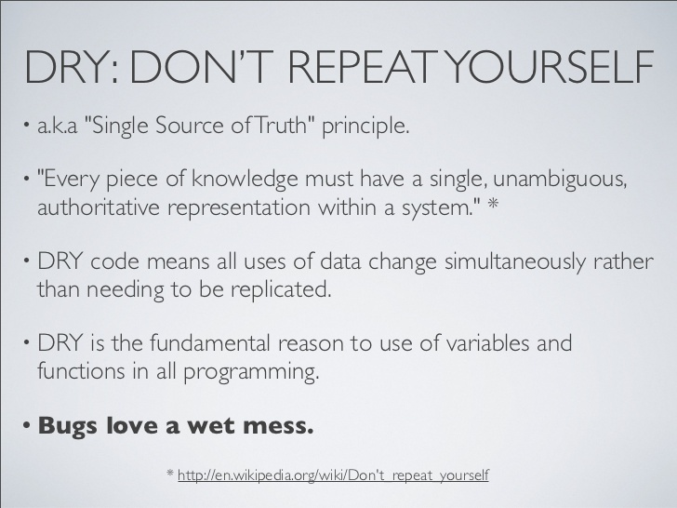
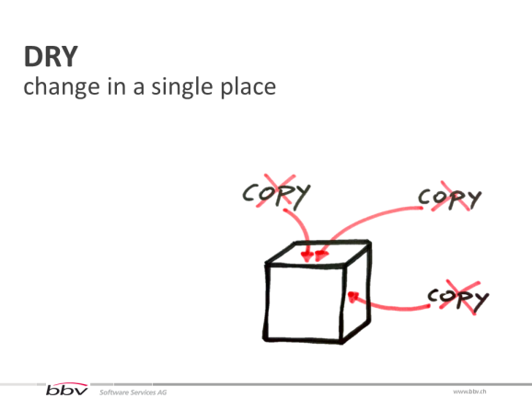
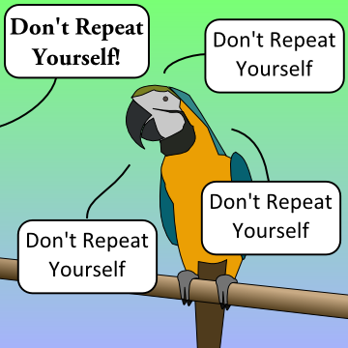
Don’t Repeat Yourself
Year 2 2nd term

Slide 18
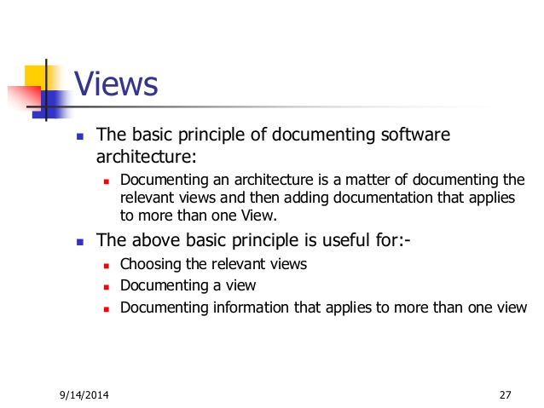
Documenting an architecture
Year 2 2nd term

Slide 19
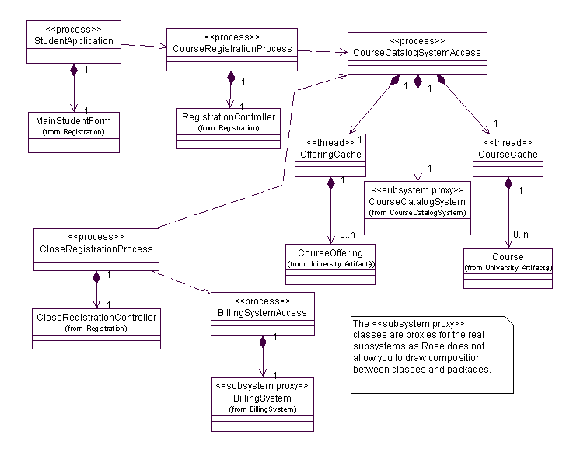
Documenting an architecture
Use diagrams for documenting a design
UML is best for Object Oriented systems
  Class diagrams to show domain concepts
  Class Diagrams to show relevant classes in implementation
  Sequence Diagrams to model important interactions and order of execution
  Component Diagrams for high-level architecture
  Composite Structure Diagrams for complicated classes (multi-threading!)
Year 2 2nd term

Slide 20
Exercise: design an architecture
Design the architecture for the privacy case study
Document it using Unified Modeling Language
Year 2 2nd term

Slide 21
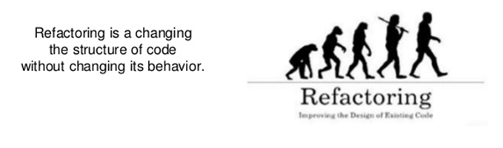
Refactoring
Year 2 2nd term

Slide 22
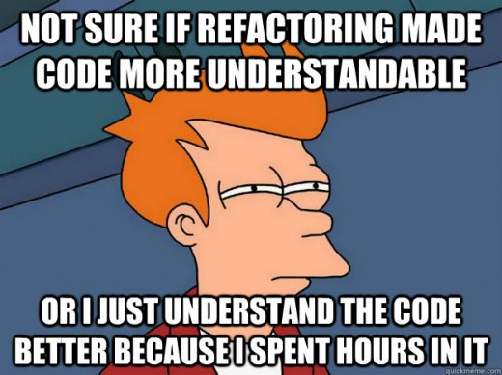
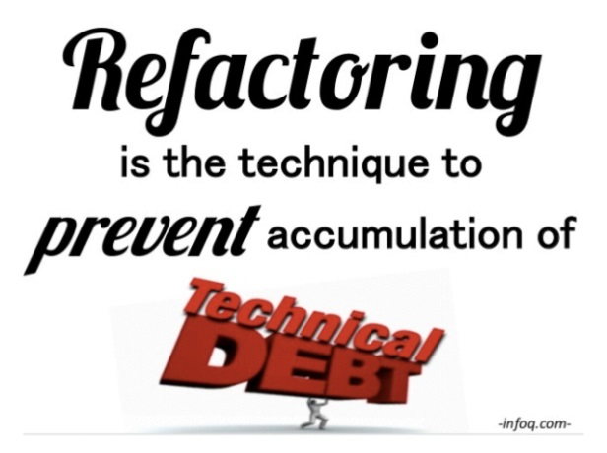
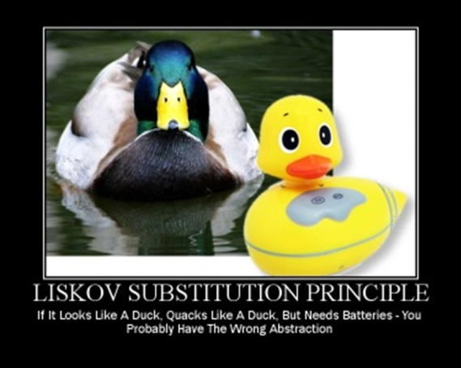
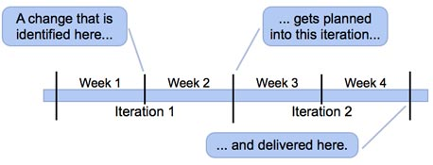
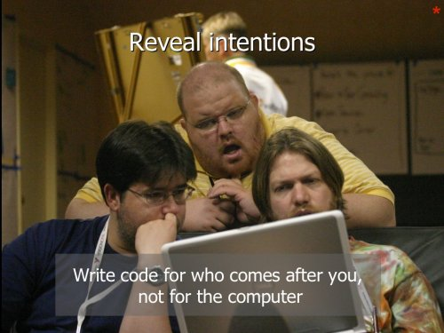
Why refactor?
Year 2 2nd term

Slide 23
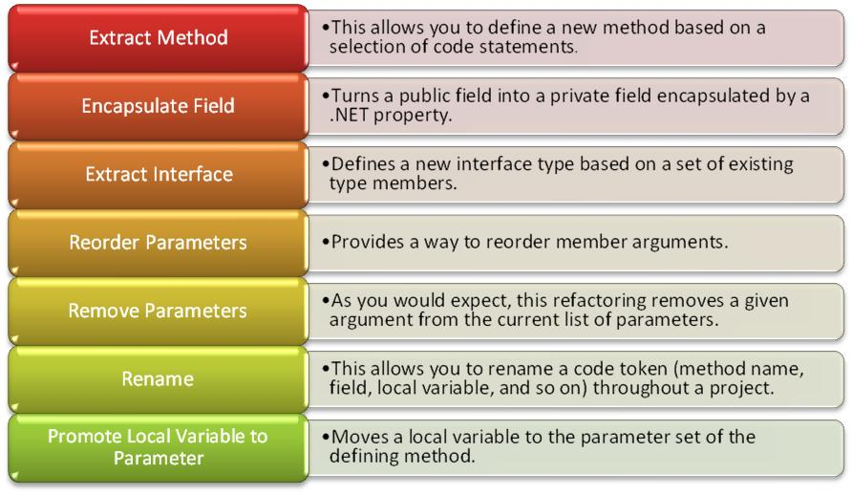
How to refactor?
Year 2 2nd term

Slide 24
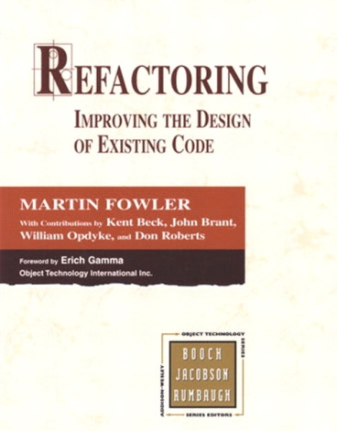

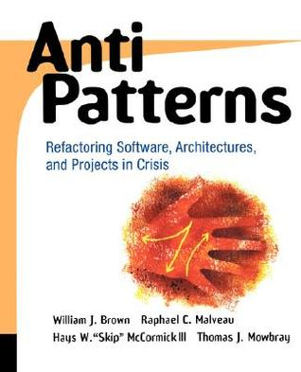
Bottom line
Year 2 2nd term

Slide 25
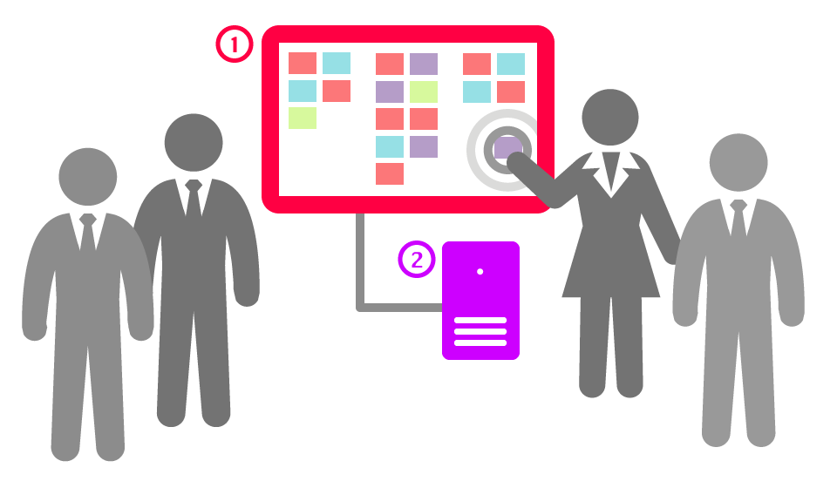
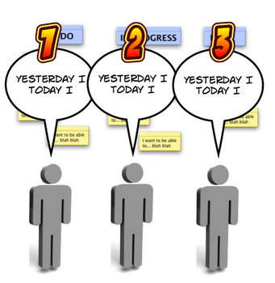
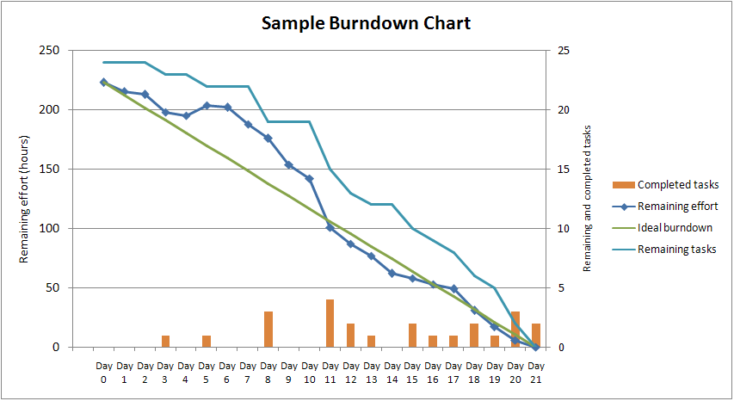
Post-refactoring stand-up meeting
Year 2 2nd term

Slide 26
Exercise
Determine the quality attributes for the EPD case study
Make an architectural design for it
Make sure it will be able to absorb the kind of changes and increments you can expect to get
Update your:
  Documentation
  Iteration planning
Year 2 2nd term

Slide 27

Homework
Read Chapter 5 from the textbook
Quickread the hardcopy text provided
Do the exercises intermingled in the book
Finish the exercises
Year 2 2nd term

